Slide 1

Choores
Project in Progress
Steve Berthiaume

Slide 2
The project is done!
But it’s for Windows only.

Slide 3
So instead… I’ve got videos!
If you have questions, please don’t hesitate to ask! By this point I’ve basically memorized the whole project like a very normal person.

Slide 4


Slide 5
Rinse & Repeat that gameplay for 7 days.
The music changes every time, but most of it is the same and it wouldn’t make sense to show you another 9 minutes of the same thing.

Slide 6
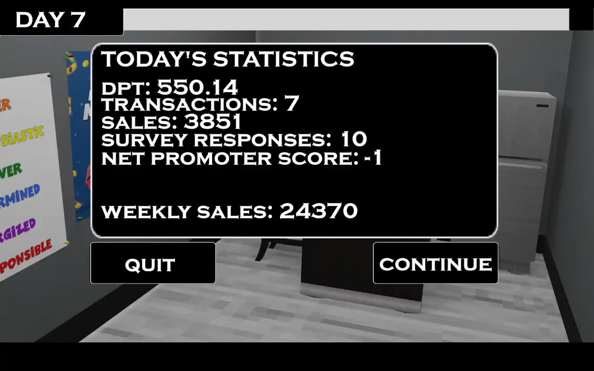

Slide 7
Feel free to ask questions!
I came overly prepared to answer them. I have all of the game’s code on the following slides. That is not a joke.

Slide 8
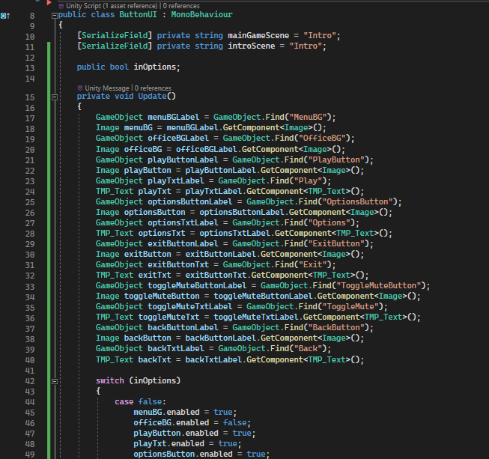
Menu Code Pt. 1
Update()

Slide 9
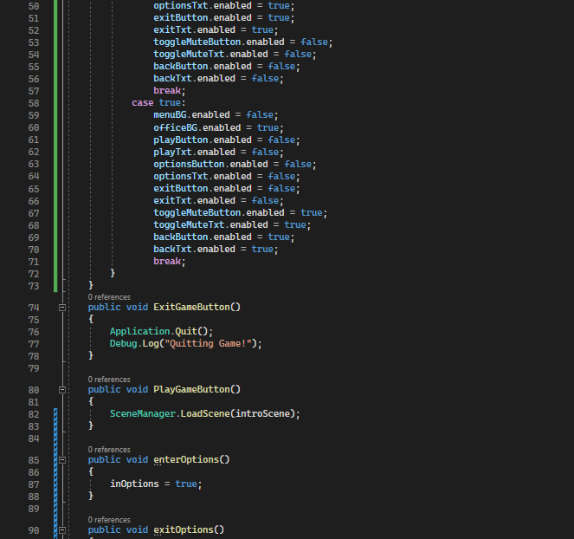
Menu Code Pt. 2
Update()
ExitGameButton()
PlayGameButton()
enterOptions()
exitOptions()

Slide 10
Menu Code Pt. 3
exitOptions()

Slide 11
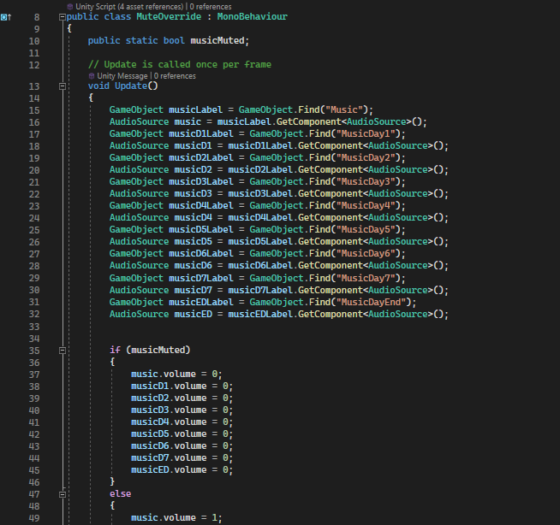
Mute Code Pt. 1
Update()

Slide 12
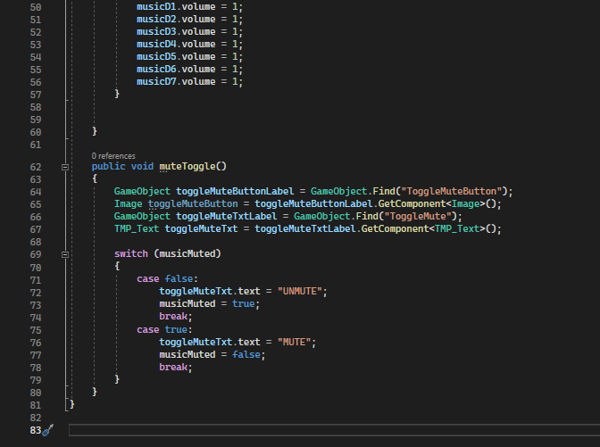
Mute Code Pt. 2
Update()
muteToggle()

Slide 13
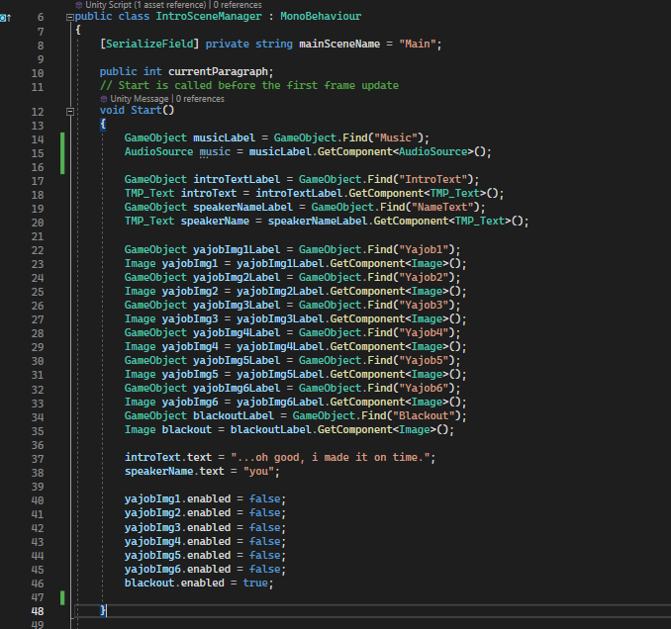
Intro Code Pt. 1
Start()

Slide 14
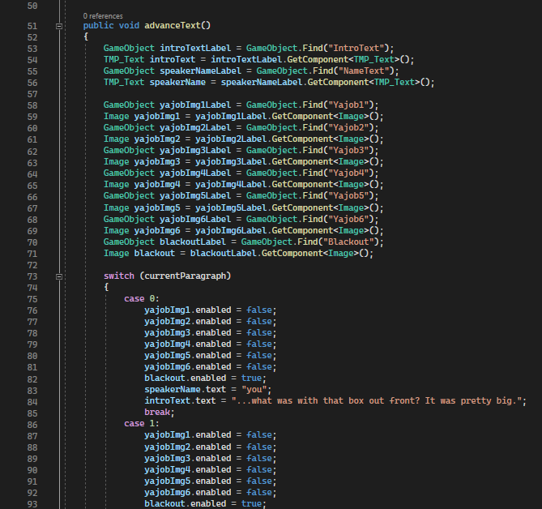
Intro Code Pt. 2
advanceText()

Slide 15
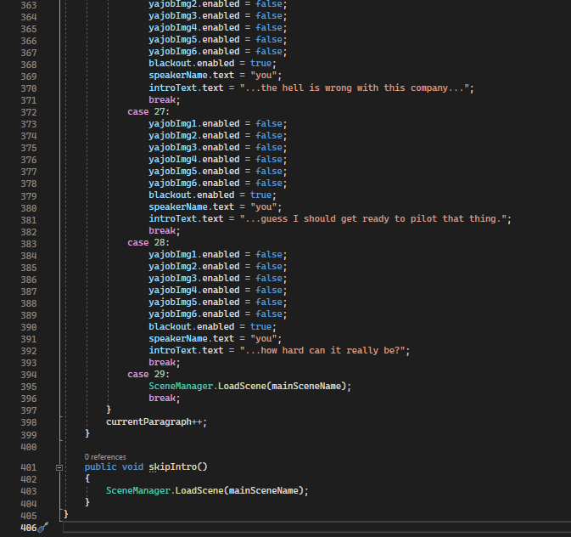
Intro Code Pt. 3
advanceText()
(yes, it is very long)
skipIntro()

Slide 16
End Code
We are skipping because it’s the same as the intro
☺

Slide 17
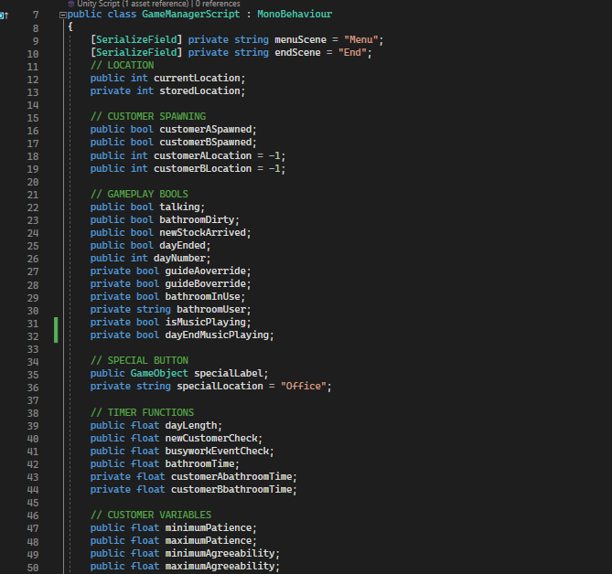
Main Code Pt. 1
Variable Declaration Pt. 1

Slide 18
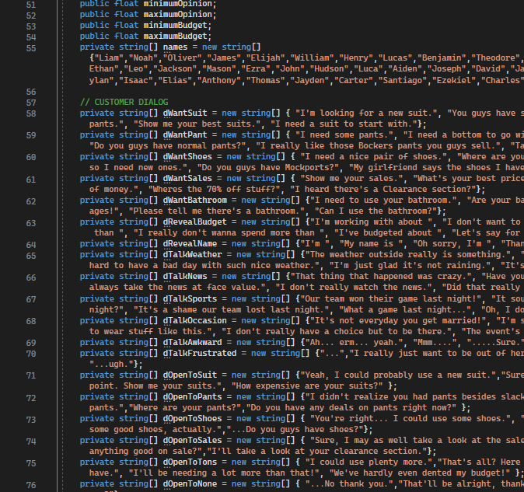
Main Code Pt. 2
Variable Declaration Pt. 2

Slide 19
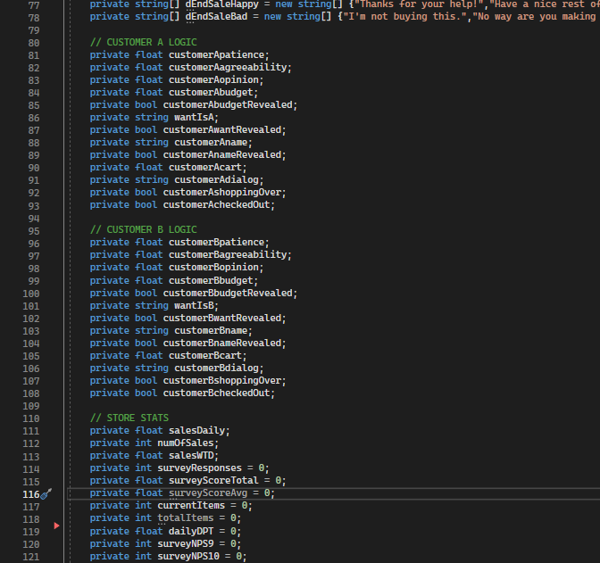
Main Code Pt. 3
Variable Declaration Pt. 3

Slide 20
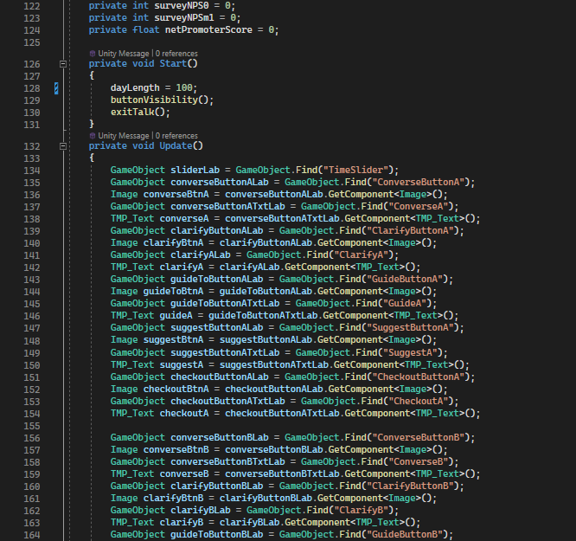
Main Code Pt. 4
Variable Declaration Pt. 4
Start()
Update()

Slide 21
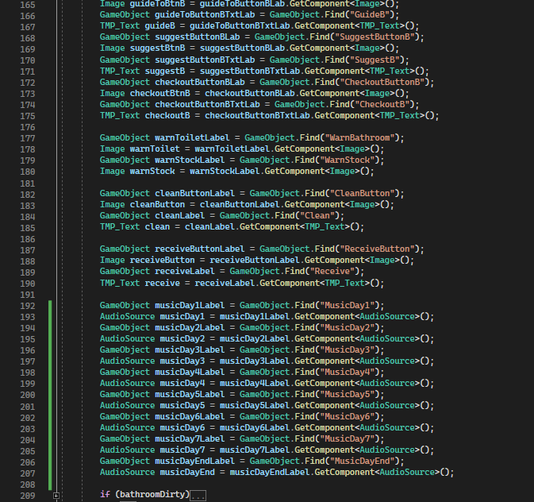
Main Code Pt. 5
Update()

Slide 22
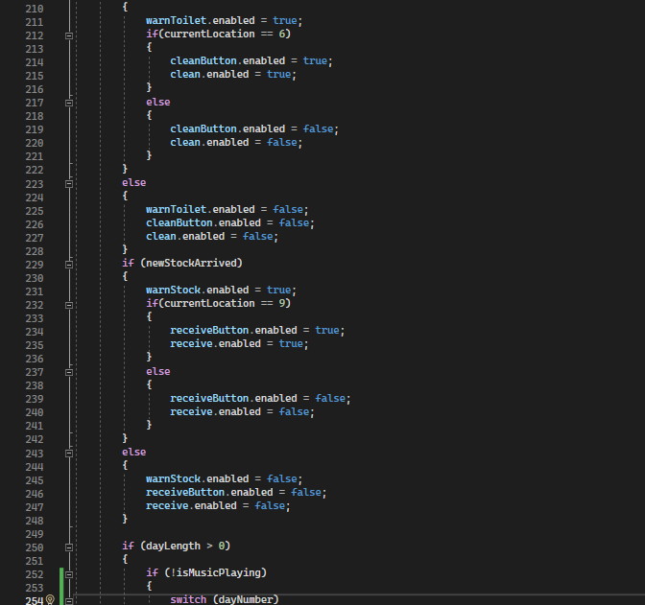
Main Code Pt. 6
Update()

Slide 23
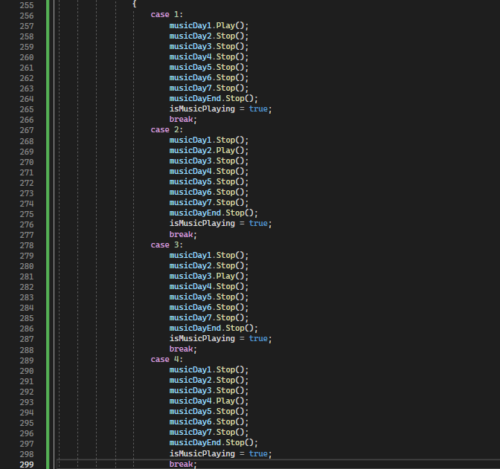
Main Code Pt. 7
Update()

Slide 24
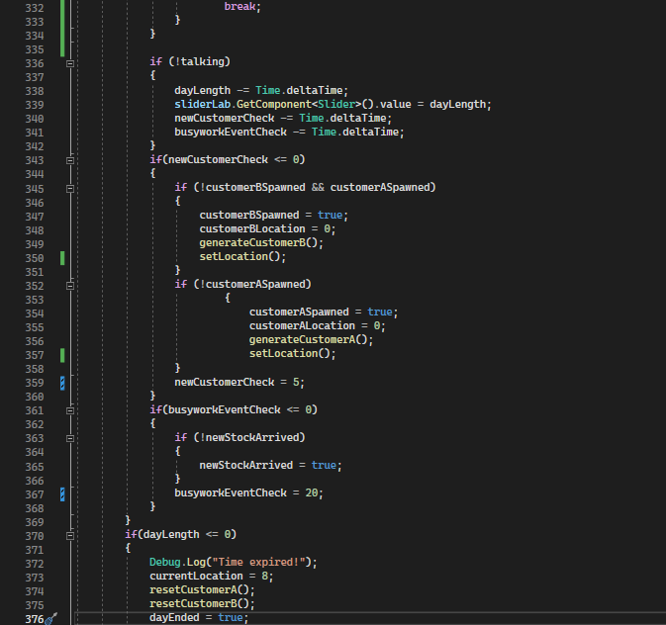
Main Code Pt. 8
Update()

Slide 25
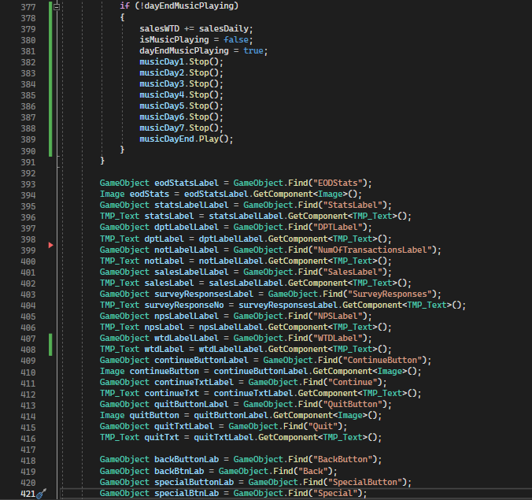
Main Code Pt. 9
Update()

Slide 26
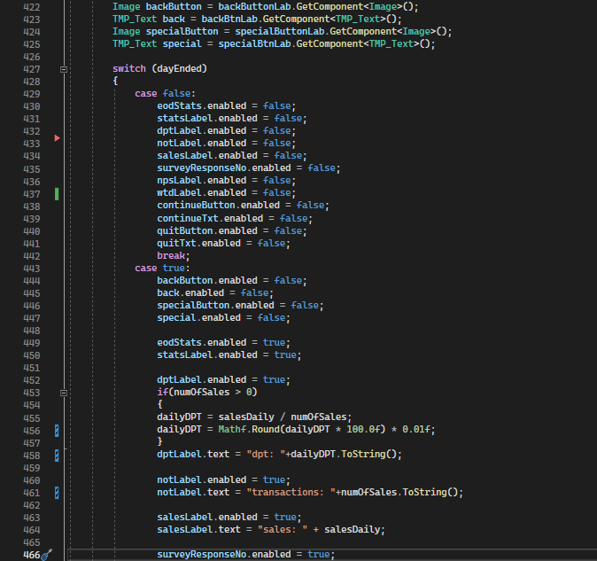
Main Code Pt. 10
Update()

Slide 27
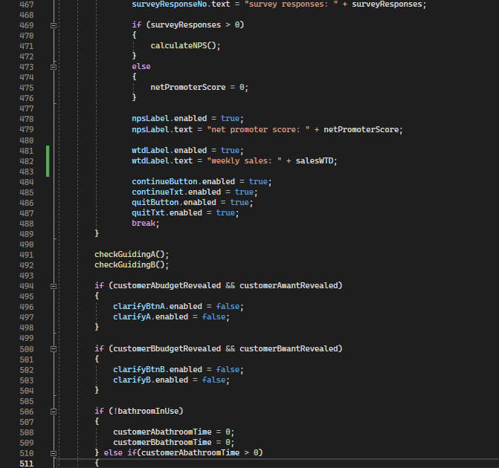
Main Code Pt. 11
Update()

Slide 28
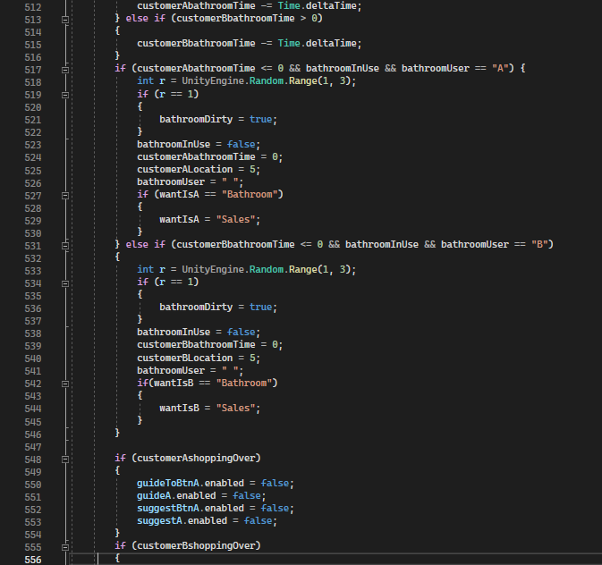
Main Code Pt. 12
Update()

Slide 29
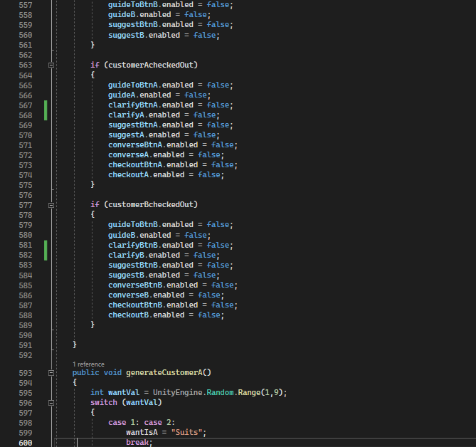
Main Code Pt. 13
Update()
generateCustomerA()

Slide 30
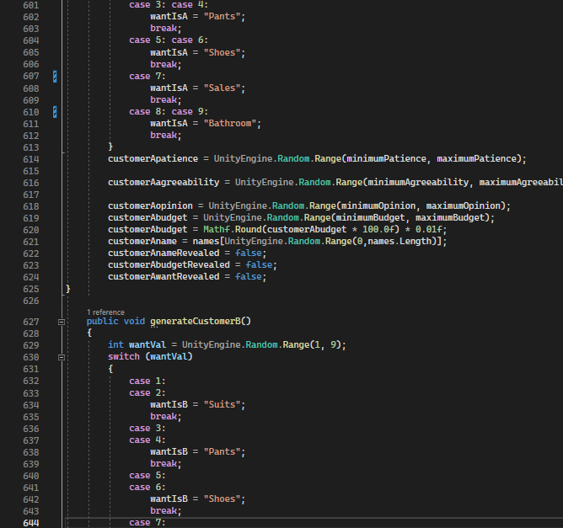
Main Code Pt. 14
generateCustomerA()
generateCustomerB()

Slide 31
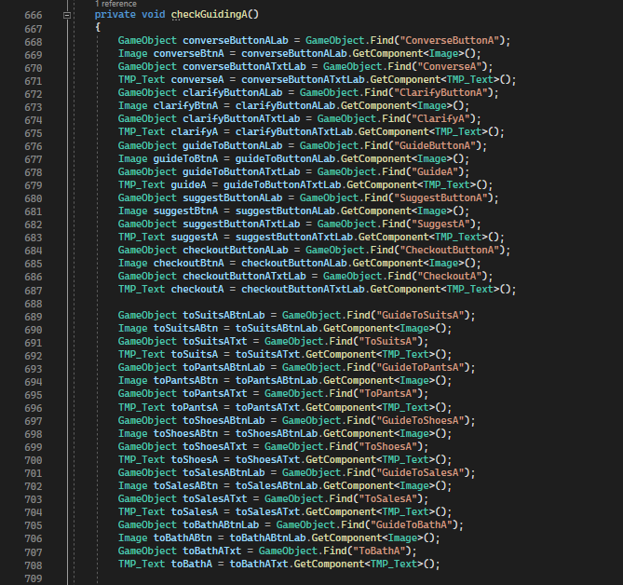
Main Code Pt. 15
checkGuidingA()

Slide 32
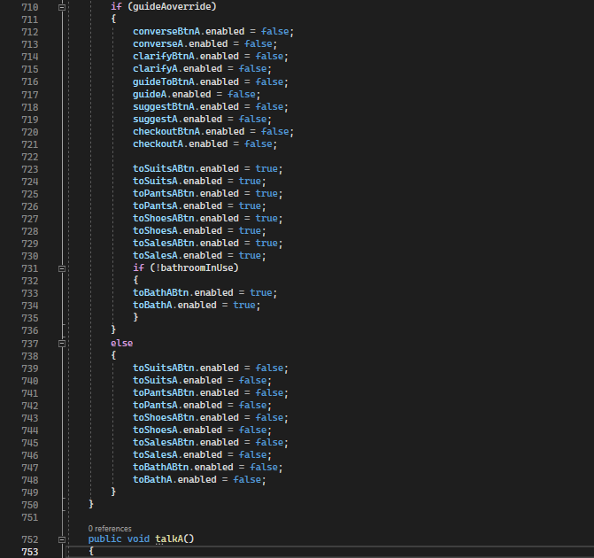
Main Code Pt. 16
checkGuidingA()
talkA()

Slide 33
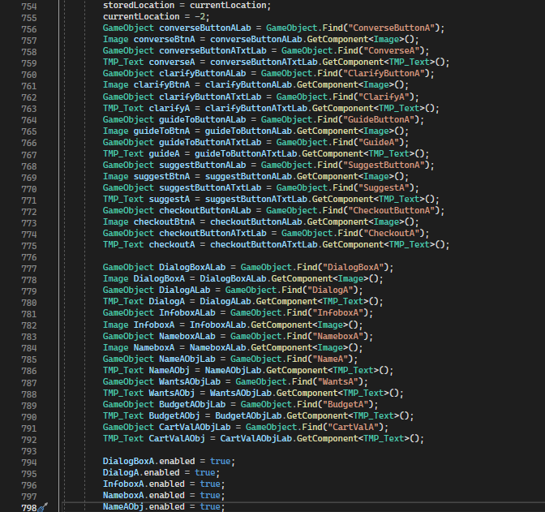
Main Code Pt. 17
talkA()

Slide 34
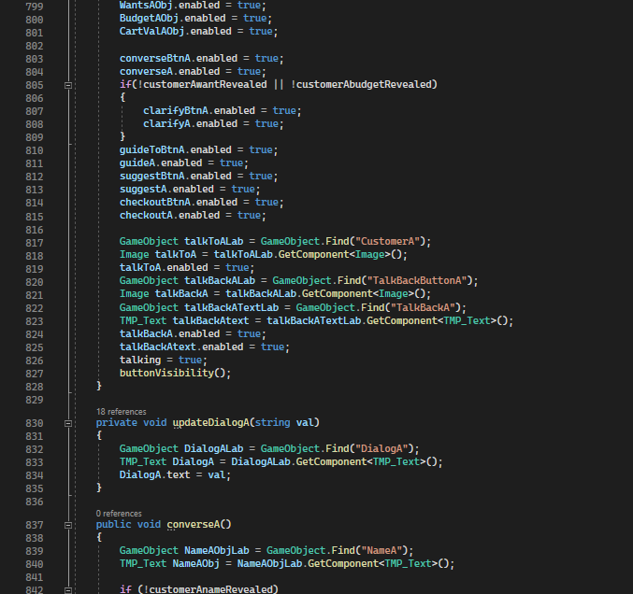
Main Code Pt. 18
talkA()
updateDialogA()
converseA()

Slide 35
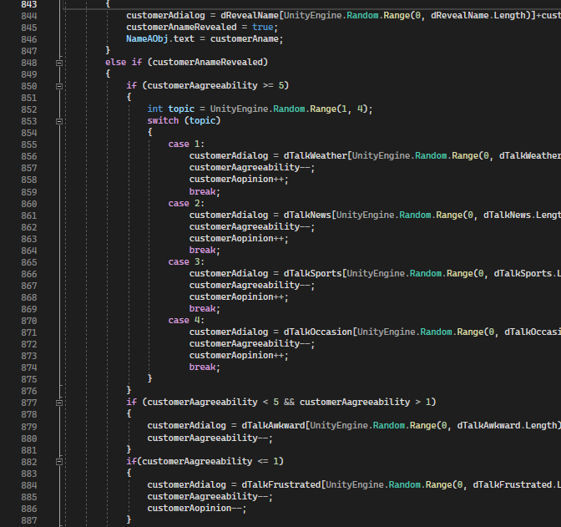
Main Code Pt. 19
converseA()

Slide 36
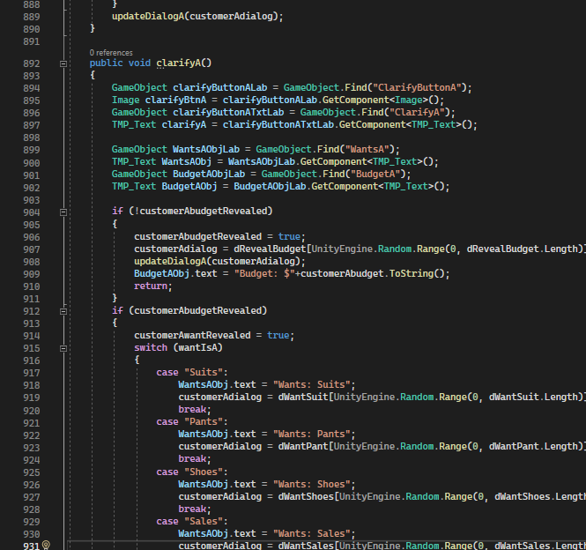
Main Code Pt. 20
converseA()
clarifyA()

Slide 37
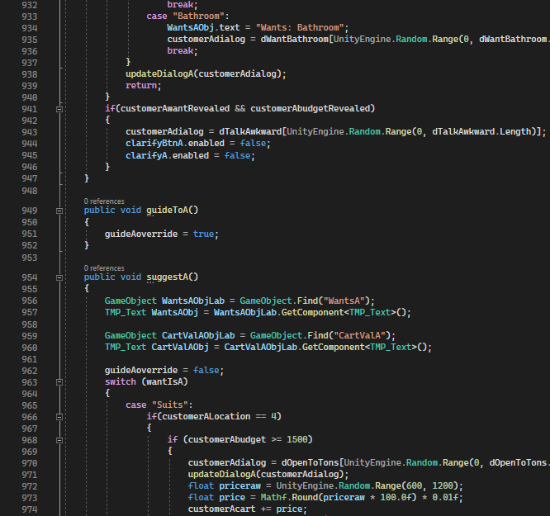
Main Code Pt. 21
clarifyA()
guideToA()
suggestA()

Slide 38
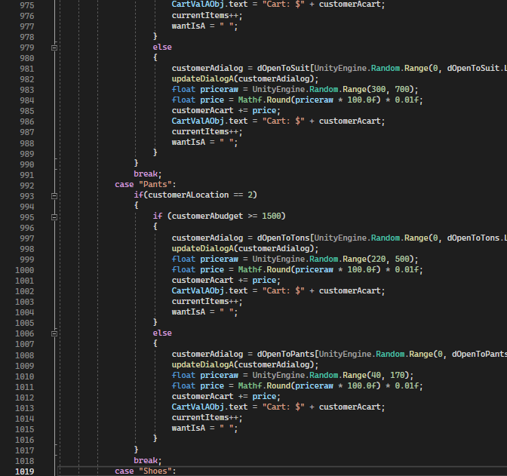
Main Code Pt. 22
suggestA()

Slide 39
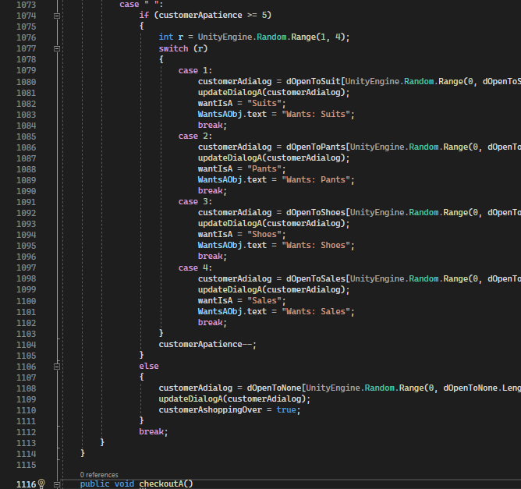
Main Code Pt. 23
suggestA()
checkoutA()

Slide 40
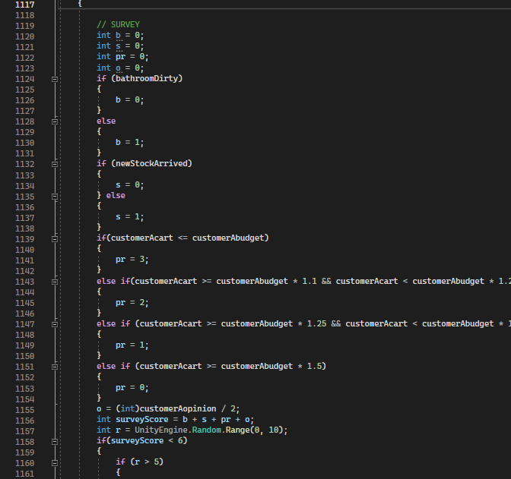
Main Code Pt. 24
checkoutA()

Slide 41
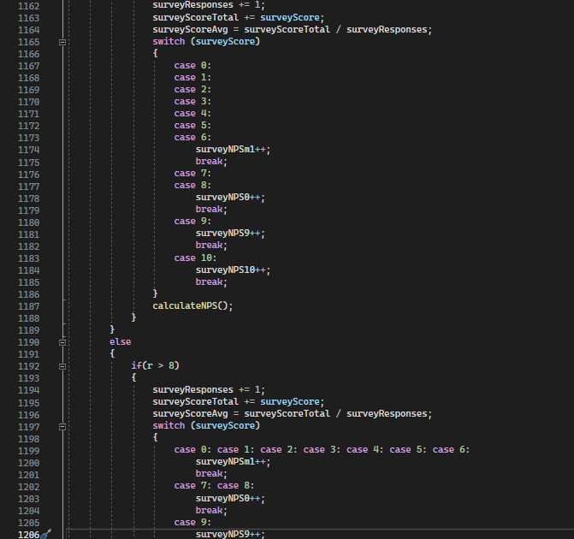
Main Code Pt. 25
checkoutA()

Slide 42
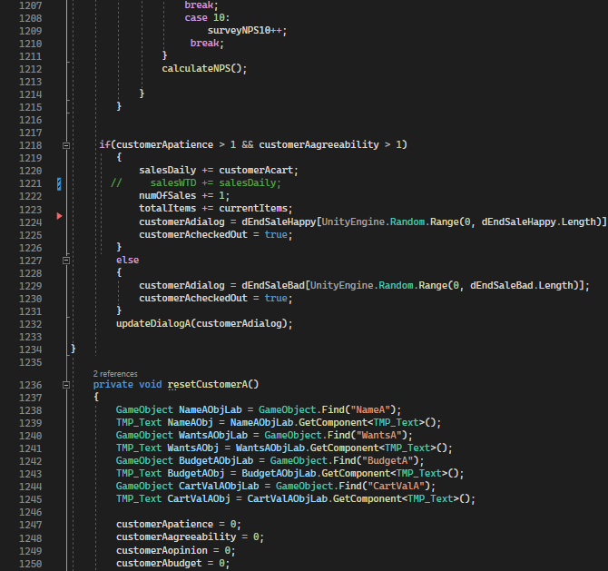
Main Code Pt. 26
checkoutA()
resetCustomerA()

Slide 43
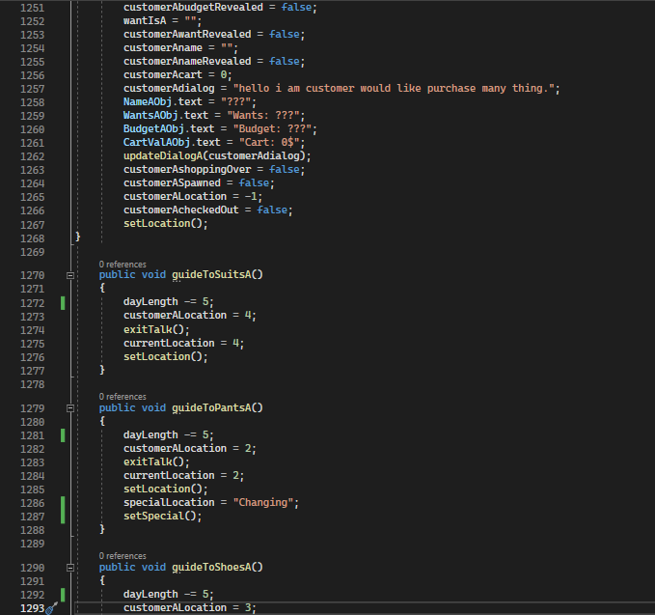
Main Code Pt. 27
resetCustomerA()
guideToSuitsA()
guideToPantsA()
guideToShoesA()

Slide 44
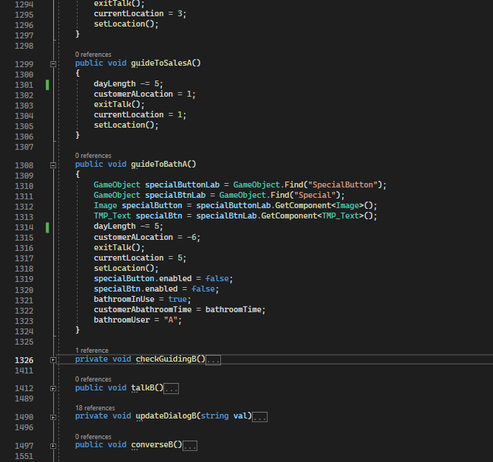
Main Code Pt. 28
guideToShoesA()
guideToSalesA()
guideToBathA()
(we’re skipping the B functions because they’re the exact same as the A equivalents)

Slide 45
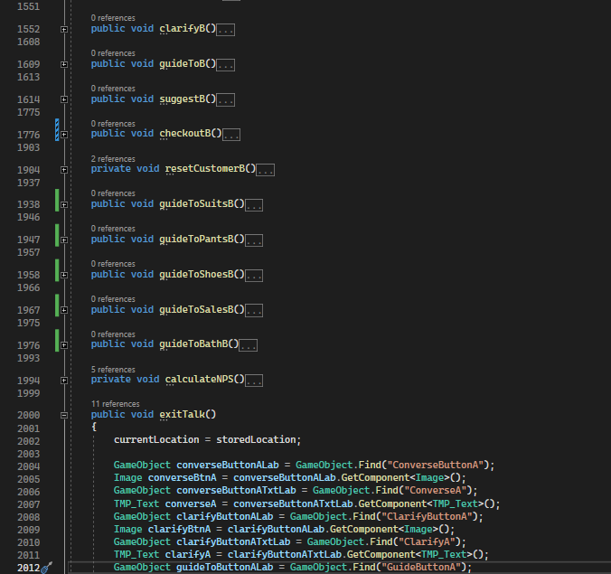
Main Code Pt. 29
(we’re skipping the B functions because they’re the exact same as the A equivalents)
exitTalk()

Slide 46
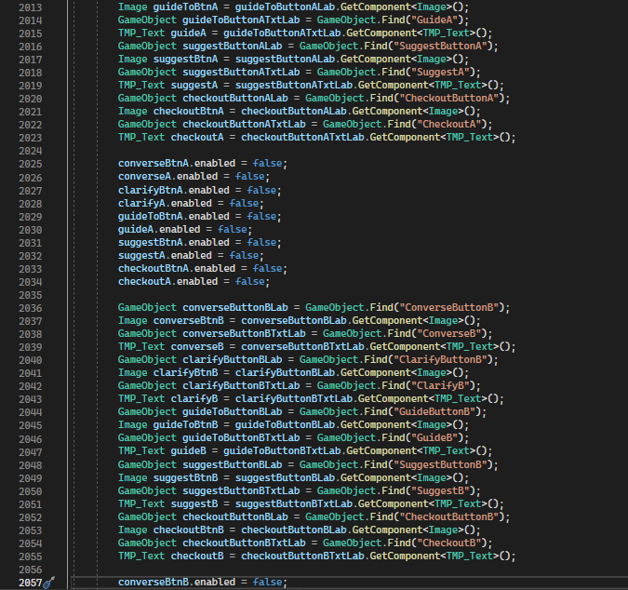
Main Code Pt. 30
exitTalk()

Slide 47
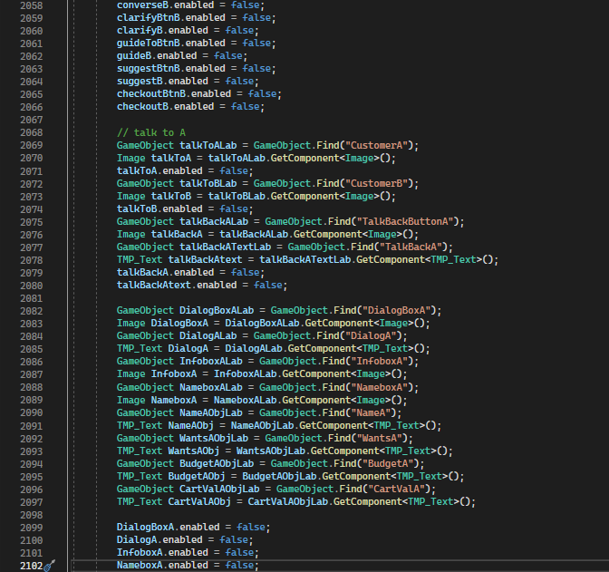
Main Code Pt. 31
exitTalk()

Slide 48
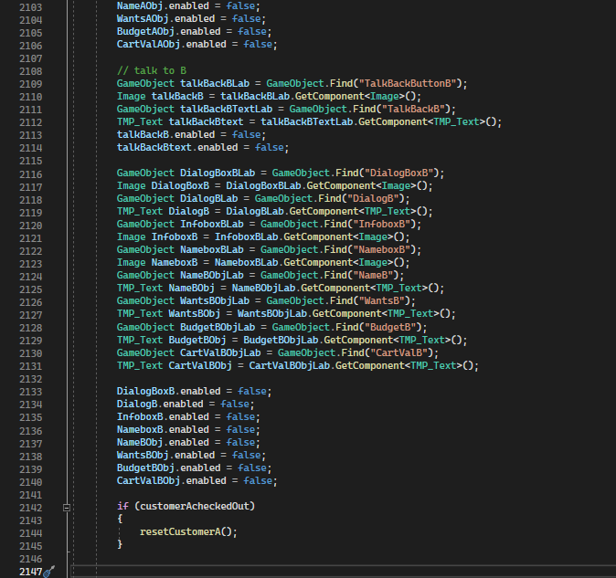
Main Code Pt. 32
exitTalk()

Slide 49
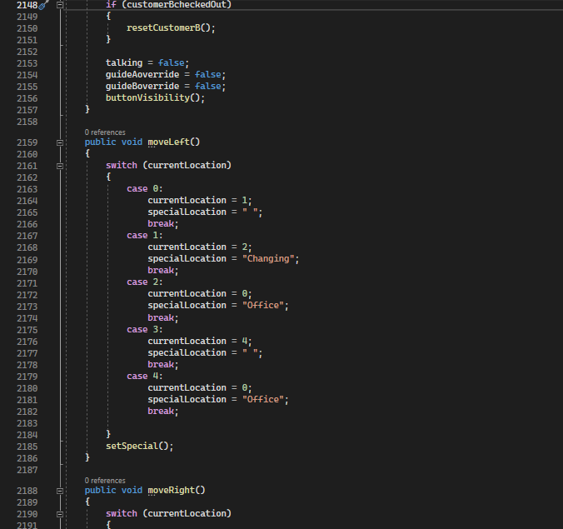
Main Code Pt. 33
exitTalk()
moveLeft()
moveRight()

Slide 50
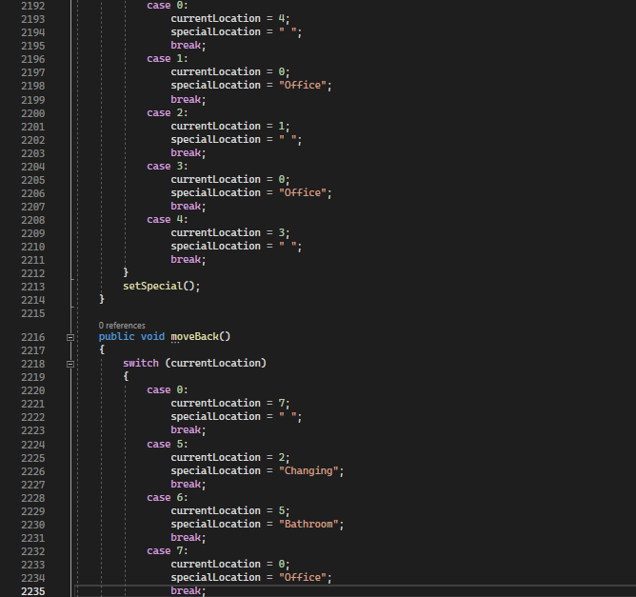
Main Code Pt. 34
moveRight()
moveBack()

Slide 51
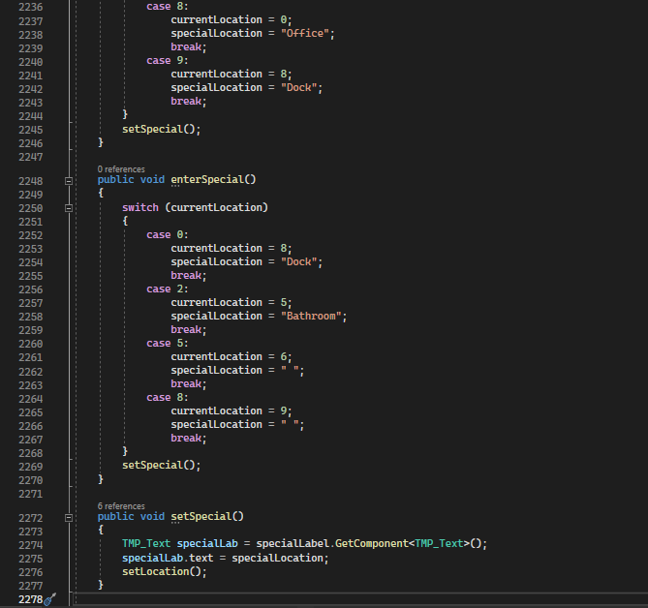
Main Code Pt. 35
moveBack()
enterSpecial()
setSpecial()

Slide 52
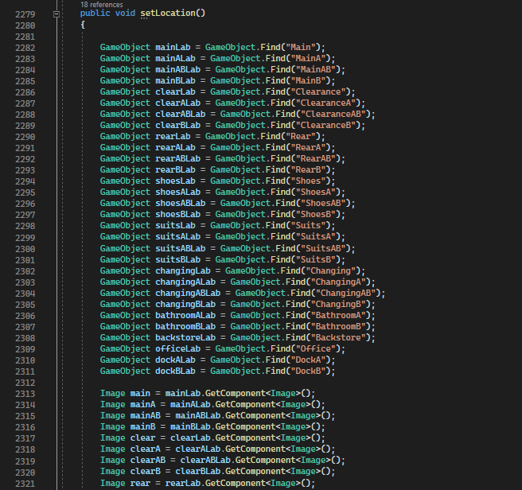
Main Code Pt. 36
setLocation()

Slide 53
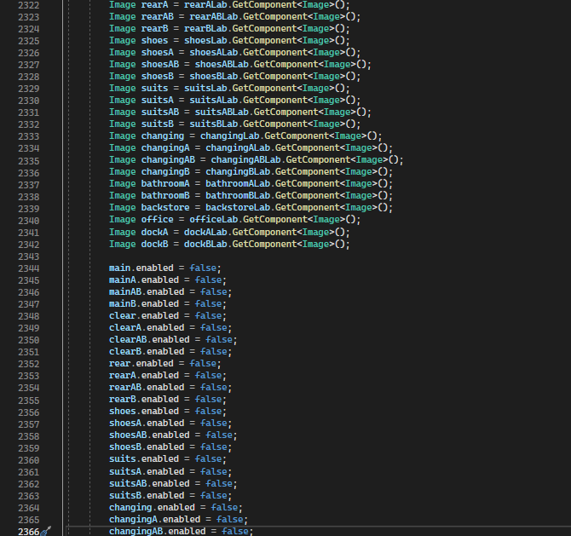
Main Code Pt. 37
setLocation()

Slide 54
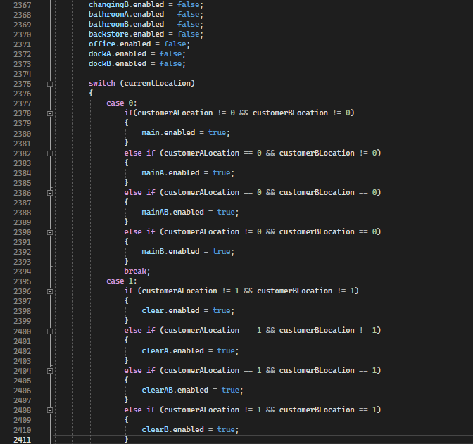
Main Code Pt. 38
setLocation()

Slide 55
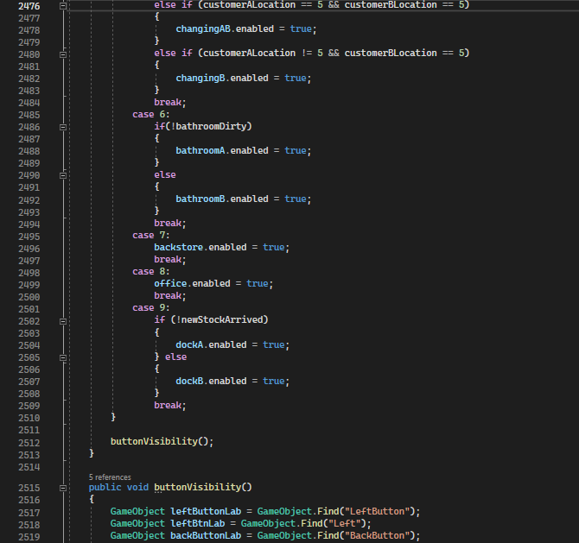
Main Code Pt. 40
setLocation()
buttonVisibility()

Slide 56
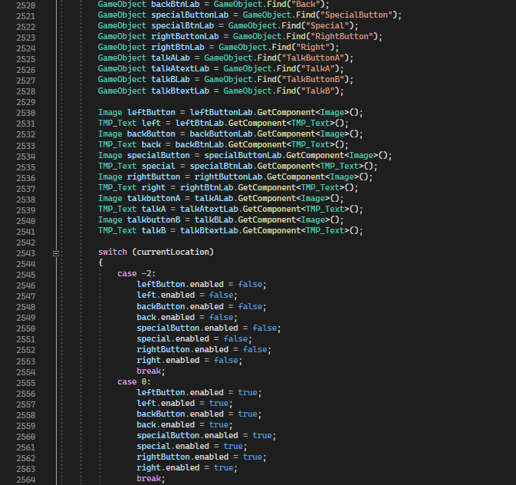
Main Code Pt. 41
buttonVisibility()

Slide 57
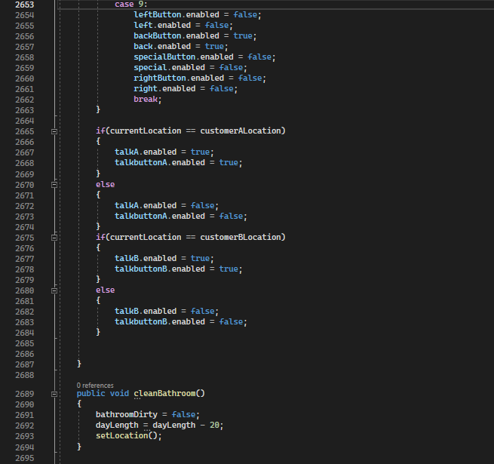
Main Code Pt. 42
buttonVisibility()
cleanBathroom()

Slide 58
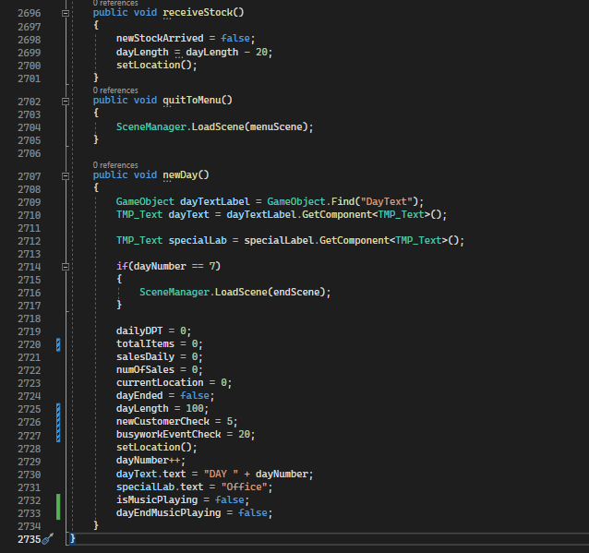
Main Code Pt. 43
receiveStock()
newDay()

Slide 59
That’s it!
Yes, that’s 2735 lines of code.

Slide 60
Pending Brad’s approval…
You can download the game yourself on steve9hw2.itch.io/choores!
(It’ll only work on Windows or Linux with .exe compatibility)

Slide 61
Special Thanks to Kevin MacLeod!
This project’s music and your internet experience wouldn’t exist without him!

Slide 62
Thank You!

